Slide 1
Fundamentals of Entrepreneurship introduction of Entrepreneurship
Who is an Entrepreneur
An Entrepreneur can be described as a person who creates, establishes, and operate a business
Venture , bears of the most of the associated risks , and makes profits from the venture.
Entrepreneurs are searching for new and exciting opportunities at all times.
Being an Entrepreneur is hard work , right from the beginning to become an Entrepreneur.
Notes:
Delete this slide when you finish preparing the other slides.

Slide 2
Millennials and the future of Entrepreneurship
future of Entrepreneurship
Milennials are reffered to as people born on or after 1981 , until around 1996
Various studies have shown that millennials are self-confident , tech-savvy ,
Multi-tasker , competitive yet optimistic , collaborate , multicultural.
Future Of Entrepreneurship
The future will be digitally dominated and entrepreneuhip is the to succeed
The latest generation is more curios , risk-tolerant , able to deal with failure.

Slide 3

Team Collaboration Together we are strong
“Coming together is a beginning. Keeping together is progress. Working together is success’’
Each team has a leader . A team leader is described as an individuals who directs , instructs , and leads a
Group of individuals who make up the team , A teams Leaders efforts are aimed at achieving a key results.
TEAM WORK AND COLLABORATION
Team bring together varied type of people , offer fresh perspective , and help find new solution.
Being part of a team can turn out to be challenging on many levels , defined roles , responsibility.
Team members are more focused on productive work as confusion and repetitive work is reduced.
GOOD LEADER
Good leadership means sharing works and responsibility with the team members.
Good leader is able to hold the team accountable for its action , increase proactiveness , and lead by example.

Slide 4
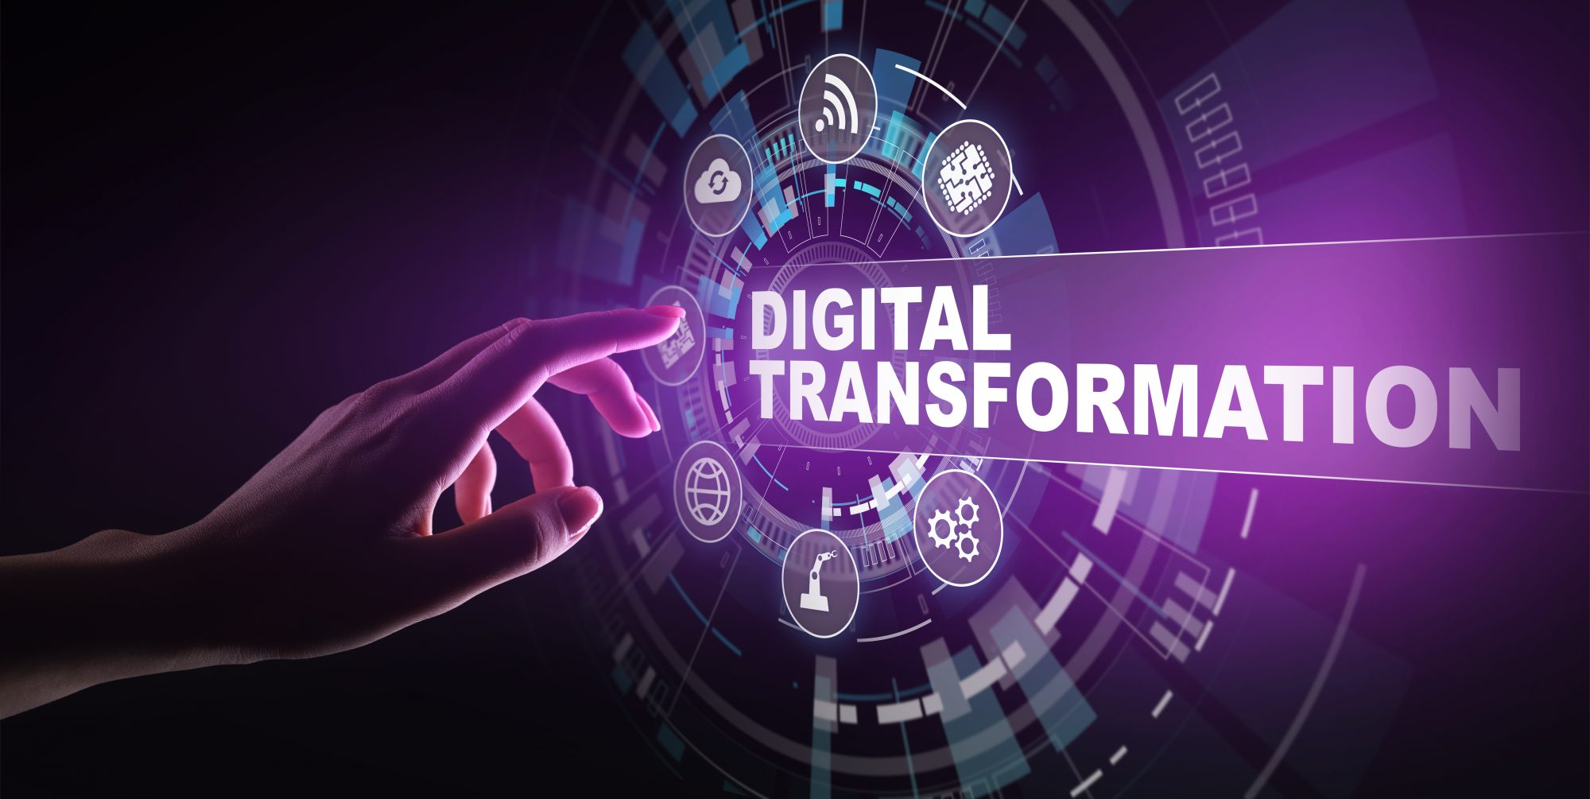

Introduction of digital transforamation

Slide 5

digital transformation & Millennial Entrepreneurs
“when digital transformation is done right ,it is like a caterpillar turning into a butterfly ,
but when done wrong all you have is a really fast caterpillar”.
WHY DIGITAL TRANSFORAMATION
In these technology-driven times, digital transformation is a critical strategy that must be applied by business.
The Covid-19 has proved to be a catalyst to digital transformation as a result new technologies have envolved.
Commonly-used digital transformation technologies
MOBILE
INTERNET OF THING
CLOUD TECHNOLOGY
ARTIFICIAL INTELLIGENCE
MACHINE LEARNING

Slide 6

SOCIAL MEDIA PLATFORMS AND THEIR IMPACT
INTRODUCTION OF SOCIAL MEDIA
SOCIAL MEDIA has permeated the lives of countless people, forced business to adopt technology in this pandemic era , transformed
How products and services are marketed and influenced consumer behavior.
LEVERAGING SOCIAL MEDIA IN BUSINESS
At present mobile application have made it possible for people to have easy access to social media .
A strong media strategy a creative content is enough to hook the audience with over 90% consumer.
A key strategy used in sourcing talent social media recruiting by advertising or posting social media .
It is safe to say that social media has become the prime marlrting tool of thi centuary .

Slide 7

Foundation of freelancing
INTRODUCTION OF FREELANCING
Freelancing is contact –based self-employement, involving both short-term and long-term team work
project , it spans across a variety of sector in the work industry freelancing depends on an individuals work.
WHO IS A FREELANCER
A freelancer is self-employed , offering his/her skill and services to different clients for a variety of jobs.
A freelancer often works for multiple clients simultaneously having contractual work on client short term
A successful freelancer has the ability to work hard , persevere , and continuously learn new things .
Most freelancer shy away from marketing . However to achieve great height as a freelancer you must learn to market yourself Successful..

Slide 8
Fundamentals of Entrepreneurship
“IF YOU START YOUR OWN THING,
YOU CAN LEARN A LOT REALLY FAST FROM DOING THINGS WRONG” THANK YOU.

